Slide 1
Fake News: Topic & Emotional Analysis
Oliver Cheng, Renata Krivenko,
Daniel Vasilyev

Slide 2
Previous Literature on Fake News
Powerful force to shape public opinion
  Political persuasion
  Changes beliefs about public health
  Relies on emotional intuition
Fake news detection using machine learning has been studied for years
  Less is known about the actual content of fake news

Slide 3
Research Questions & Data
What are the most prevalent topics in fake news during the years of 2015-2018?
How do emotions between real news and fake news compare during the years of 2016 - 2017?
Fake news from 2015 - 2018
Real news from 2016 - 2017
  Contains training and testing data from fake news detection study

Slide 4
Methodology
Data Collection & Cleaning
Topic Modeling for Fake News
Emotional Analysis for Real and Fake News
Notes:
Data Cleaning/Collection
Removing stop words (it, the, and)
Tokenization - long text is divided into meaningful word units
Lemmatization - words are returned to their base form (running/runs/ran all turn into run)
Topic Analysis
Using LDA model to identify 6 topics within each year of fake news
Each topic are words/phrases that relate to one another and an overall theme can be determined
Emotional Analysis
Using transformers package with preloaded emotion libraries
This specific package detects 7 different emotions

Slide 5
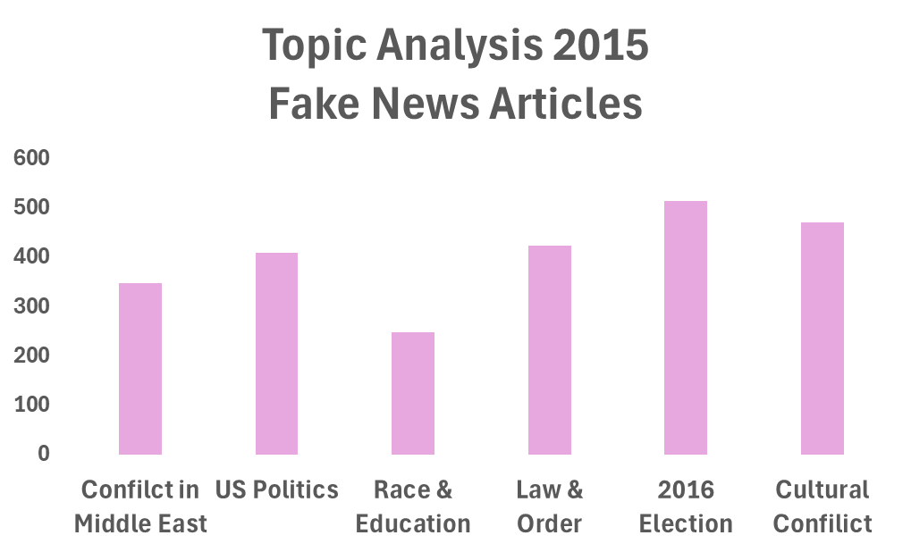
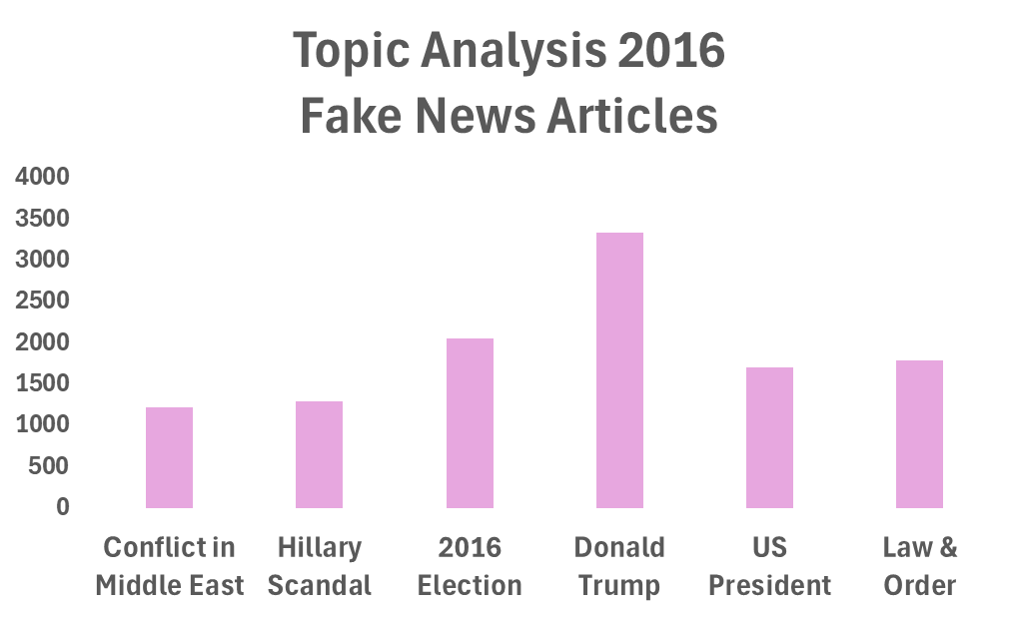
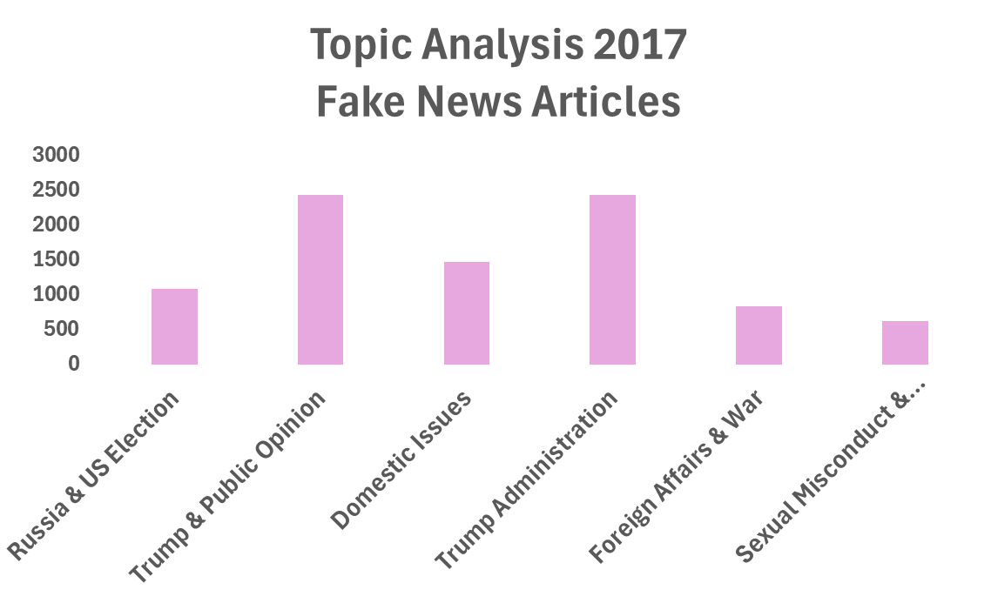
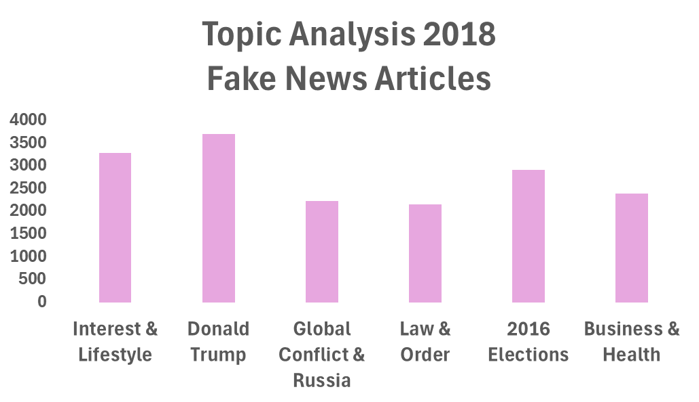
Topic Analysis Results

Slide 6
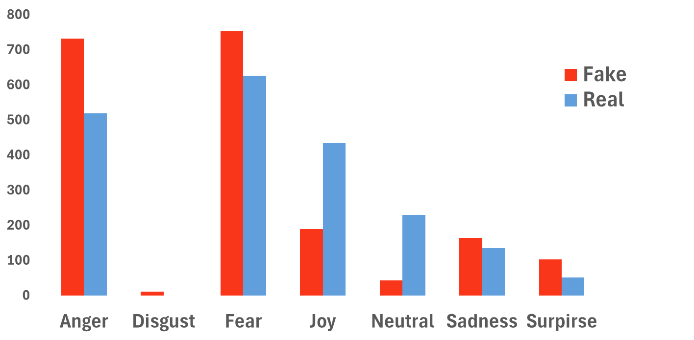
Emotional Analysis On Article Text

Slide 7
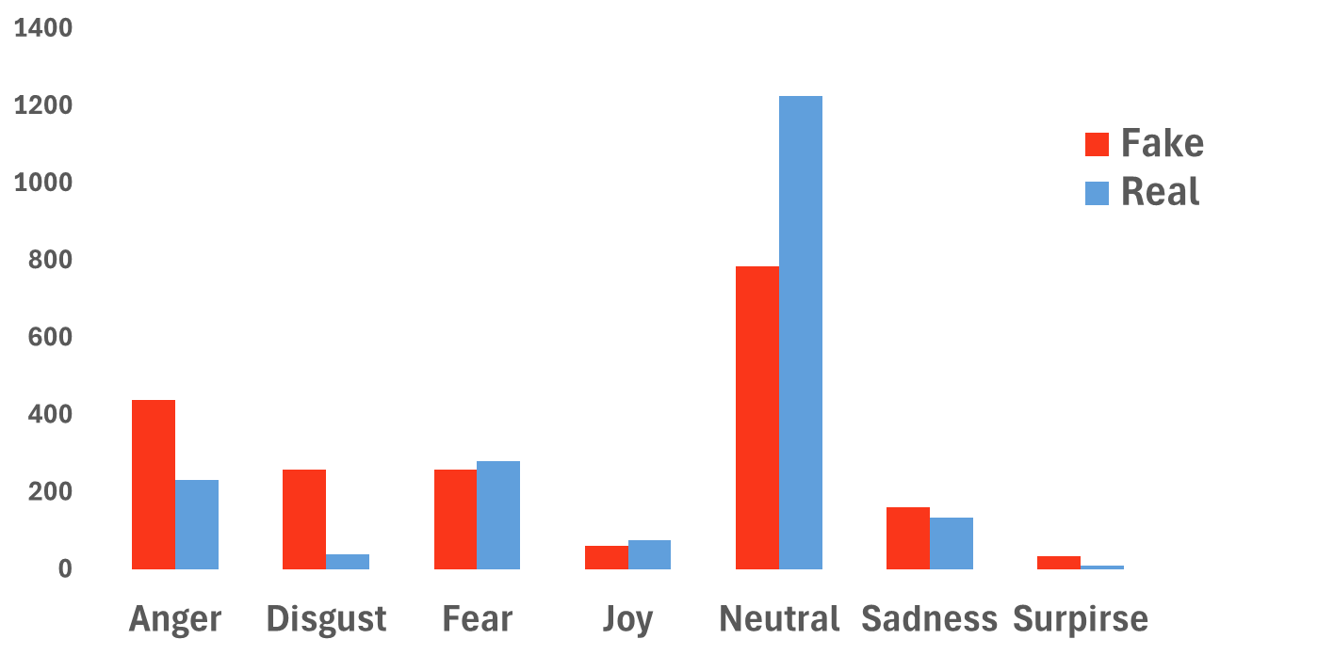
Emotional Analysis On Article Titles

Slide 8
Conclusions
What are the most prevalent topics in fake news during the years of 2015-2018?
  Controversial topics are the most prevalent
  Focuses on what is the main concerns during those years (politics to rumors about health and global events)
How do emotions between real news and fake news compare during the years of 2016 - 2017?
  Article Text
    Fake news leverages fear and anger
    Real News has more emotional distribution
  Article Titles
    Both are more neutral
    More anger and disgust in fake news

Slide 9
Final Discussions
Limitations
Not many years of fake and real news datasets available
Limited amount of text able to go through the transformers model (512 characters per row)
Future Steps
Continue topic analysis on more current fake and real news
Compare to sways in public opinion to see how these topics influence readers

